Slide 1
Distributed System
by
Mr Alok Tiwari
(CSE Department)
KIET Group of Institutions

Slide 2
Contents
Transactions and Concurrency Control
Nested transactions

Slide 3
Transaction
  A transaction is a program including a collection of database operations, executed as a logical unit of data processing.

Slide 4
Transaction Operations
begin_transaction
read_item or write_item
end_transaction
commit
rollback

Slide 5
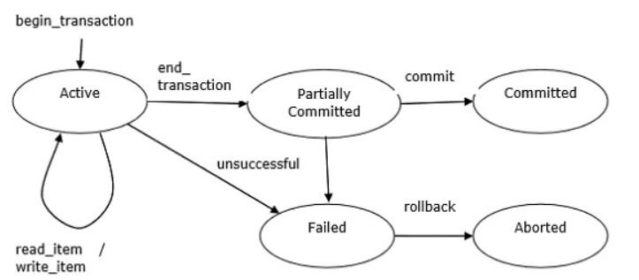
Transaction States

Slide 6
Desirable Properties of Transactions
Atomicity
Consistency
Isolation
Durability

Slide 7
Concurrency control
    Motivation: without concurrency control, we have lost updates, inconsistent retrievals, dirty reads, etc. (see following slides)
    Concurrency control schemes are designed to allow two or more transactions to be executed correctly while maintaining serial equivalence
      Serial Equivalence is correctness criterion
        Schedule produced by concurrency control scheme should be equivalent to a serial schedule in which transactions are executed one after the other
    Schemes:
      locking,
      optimistic concurrency control,
      time-stamp based concurrency control
Transactions

Slide 8
The Lost Update Problem
In the lost update problem, update done to a data item by a transaction is lost as it is overwritten by the update done by another transaction.

Slide 9
The inconsistent retrievals problem
    Inconsistent Retrievals Problem is also known as unrepeatable read. When a transaction calculates some summary function over a set of data while the other transactions are updating the data, then the Inconsistent Retrievals Problem occurs.
    A transaction T1 reads a record and then does some other processing during which the transaction T2 updates the record. Now when the transaction T1 reads the record, then the new value will be inconsistent with the previous valu

Slide 10
Nested transactions
T : top-level transaction
T
1
= openSubTransaction
T
2
= openSubTransaction
commit
T
1
:
T
2
:
openSubTransaction
openSubTransaction
openSubTransaction
prov. commit
abort
T
11
:
T
12
:
T
21
:
openSubTransaction
prov. commit
prov. commit
prov. commit
T
211
:
prov.commit
provisional commit
Transactions

Slide 11
Committing Nested Transactions
    A transaction may commit or abort only after its child transactions have completed
    When a sub-transaction completes, it makes an independent decision either to commit provisionally or to abort. Its decision to abort is final.
    When a parent aborts, all of its sub-transactions are aborted.
    When a sub-transaction aborts, the parent can decide whether to abort or not.
    If a top-level transaction commits, then all of the sub-transactions that have provisionally committed can commit too, provided that non of their ancestors has aborted.
Transactions

Slide 12
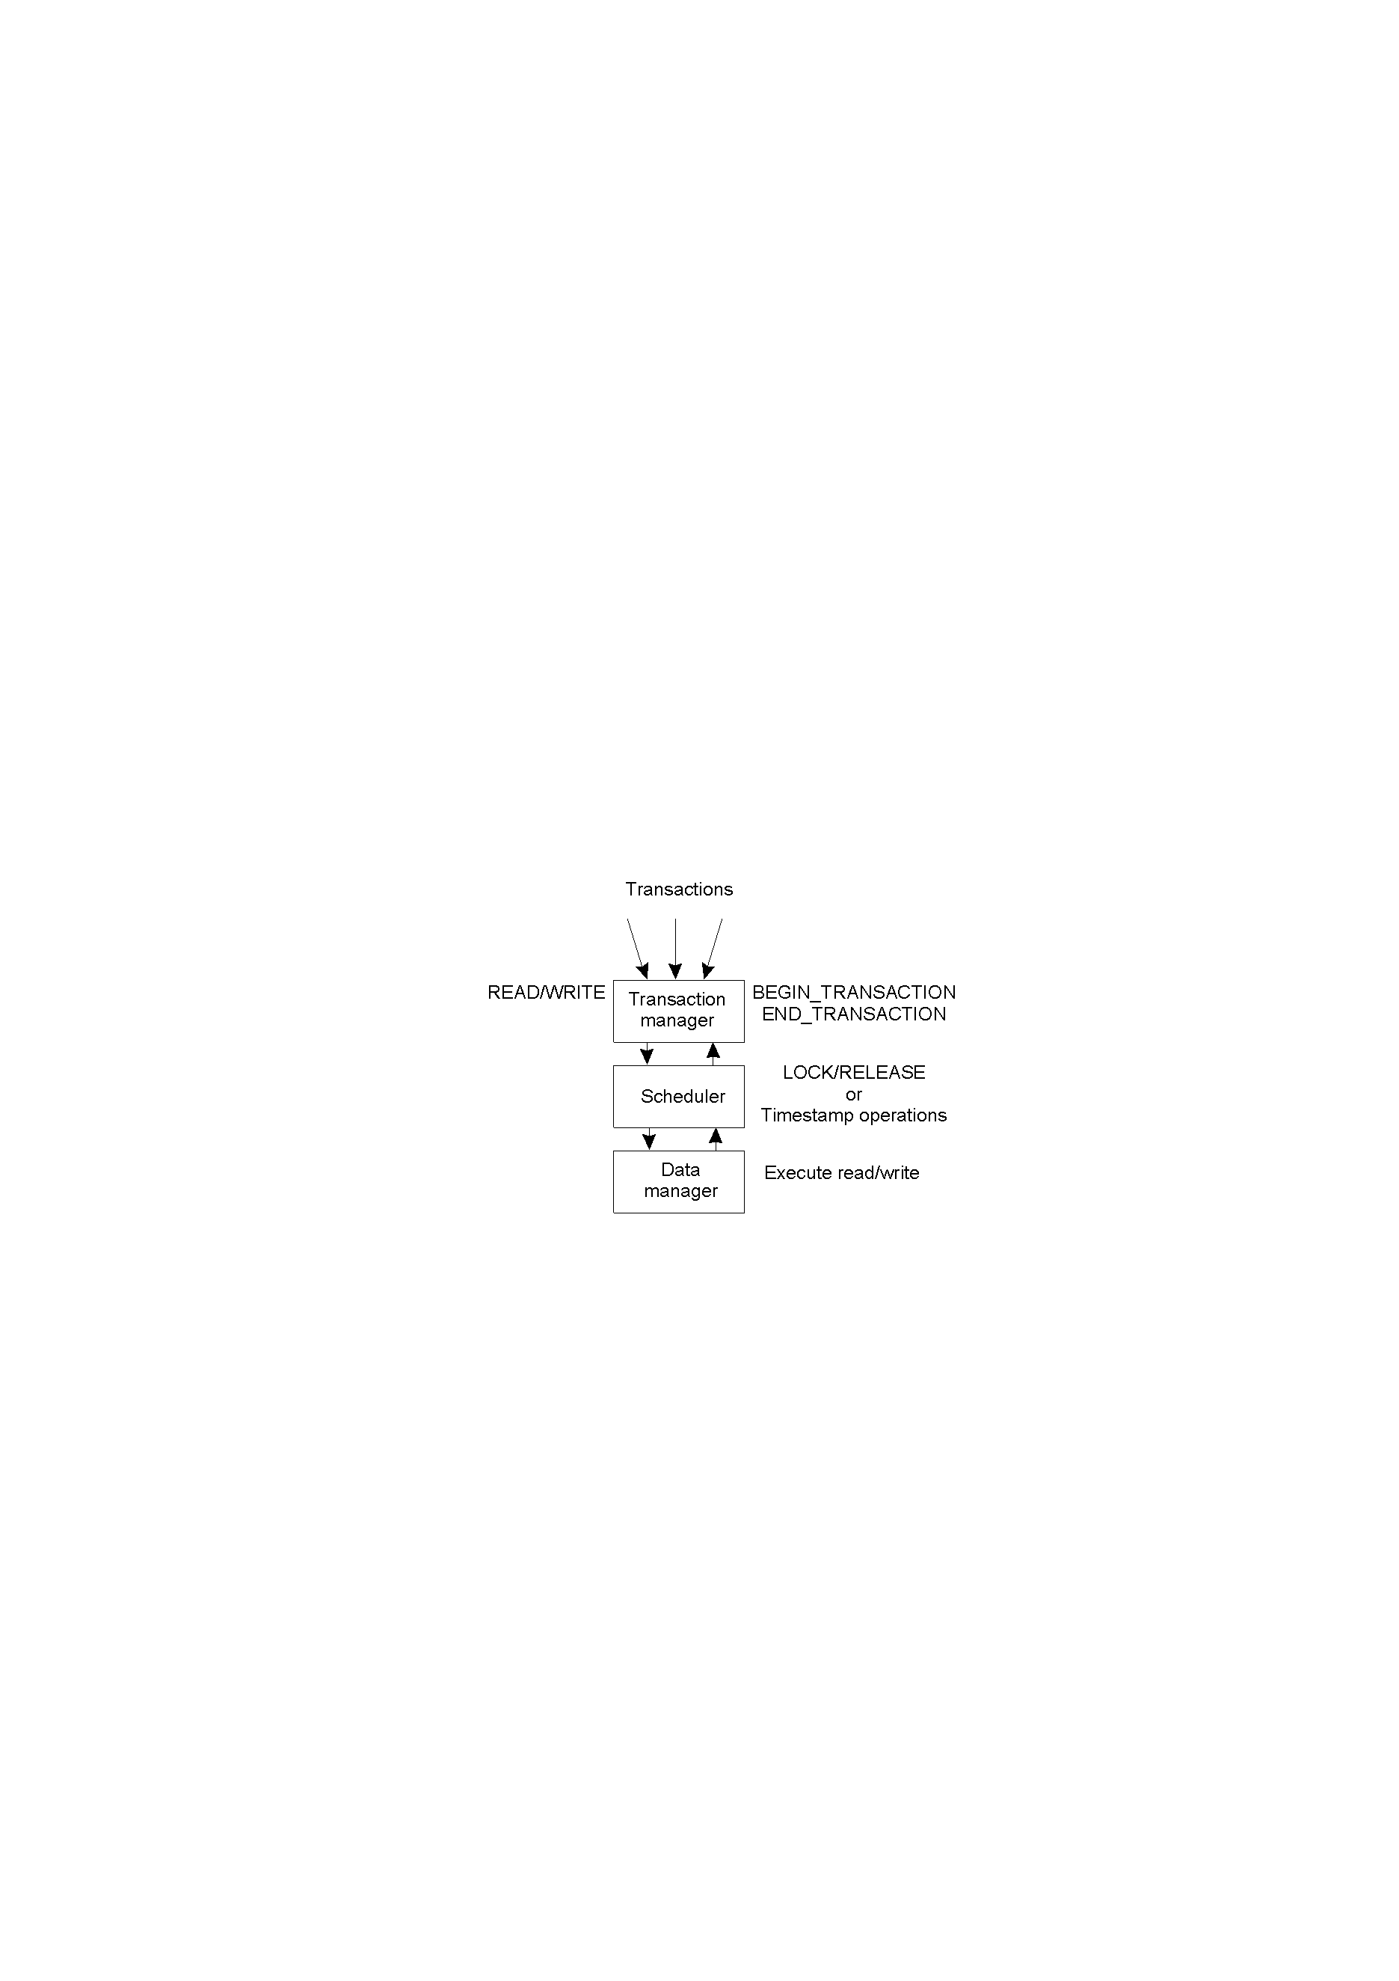
Concurrency Control
  General organization of managers for handling transactions.
Transactions

Slide 13
Schemes for Concurrency control
Locking
  Server attempts to gain an exclusive ‘lock’ that is about to be used by one of its operations in a transaction.
  Can use different lock types (read/write for example)
  Two-phase locking
Optimistic concurrency control
Time-stamp based concurrency control
Transactions

Slide 14
Thank
You

